Slide 1
Web Science:
Collective Intelligence & Recommender Systems
(Part 1 - Collective Intelligence)
CS 432/532
Old Dominion University
Permission has been granted to use these slides from Frank McCown, Michael L. Nelson, Alexander Nwala, Michele C. Weigle
This work is licensed under a Creative Commons Attribution-NonCommercial-ShareAlike 3.0 Unported License

Slide 2
Main reference:
Ch 1 from Programming Collective Intelligence by Toby Segaran
(abbreviated as PCI)

Slide 3
What is Collective Intelligence?
Human Computation
Crowd- sourcing
Social Computing
Collective Intelligence
Data Mining
Quinn and Bederson, “Human computation: A survey and taxonomy of a growing field”, CHI 2011

Slide 4
Collective Intelligence
"groups of individuals doing things collectively that seem intelligent." Thomas Malone, Director of MIT Center for Collective Intelligence, 2006
"when technologists use this phrase they usually mean the combining of behavior, preferences, or ideas of a group of people to create novel insights." Segaran, Programming Collective Intelligence (PCI), p. 2

Slide 5
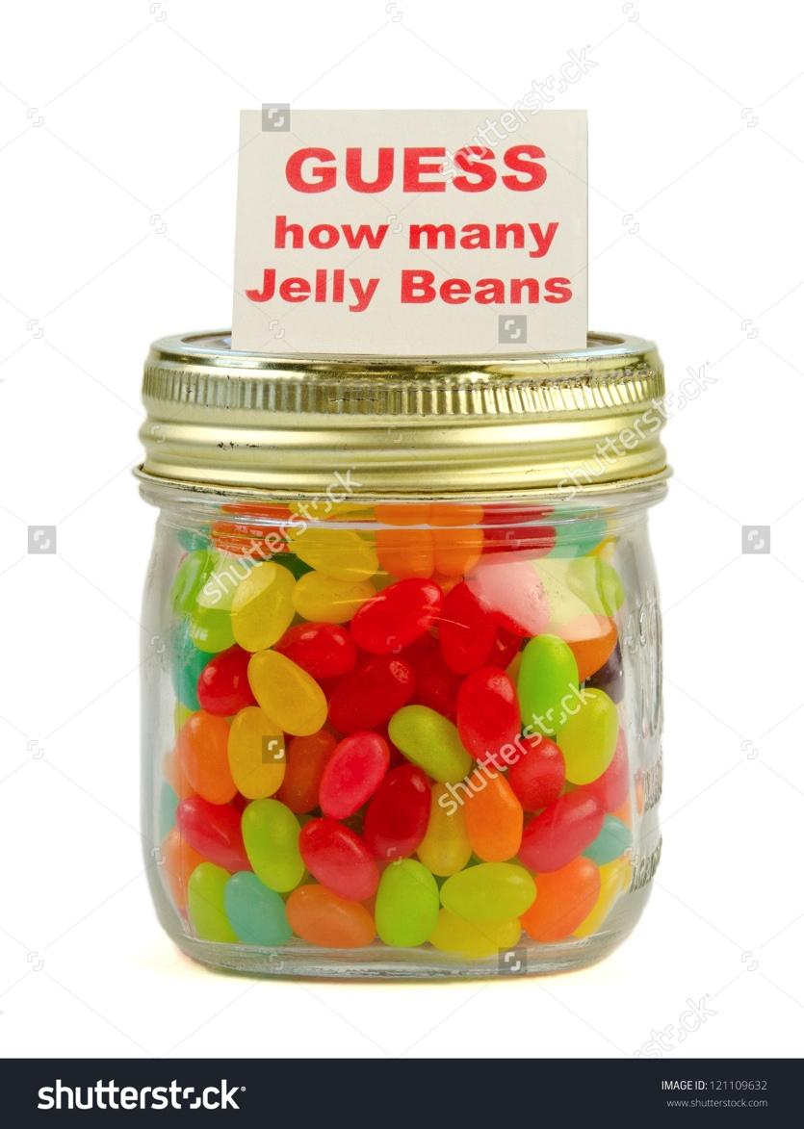
img source: https://www.shutterstock.com/image-photo/guess-how-many-jelly-beans-mason-121109632
Crowd-sourced strategies: How to Count Jelly Beans in a Jar, How to win a guess the number of jelly beans in a jar contest

Slide 6
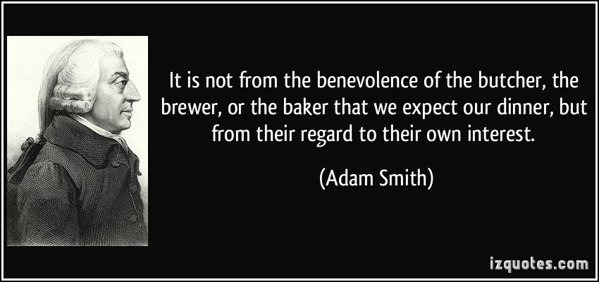
Collective Intelligence in Classical Economic Theory
Invisible hand (Wikipedia)
The Wealth of Nations (Wikipedia)

Slide 7
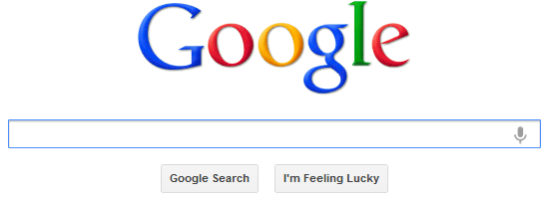
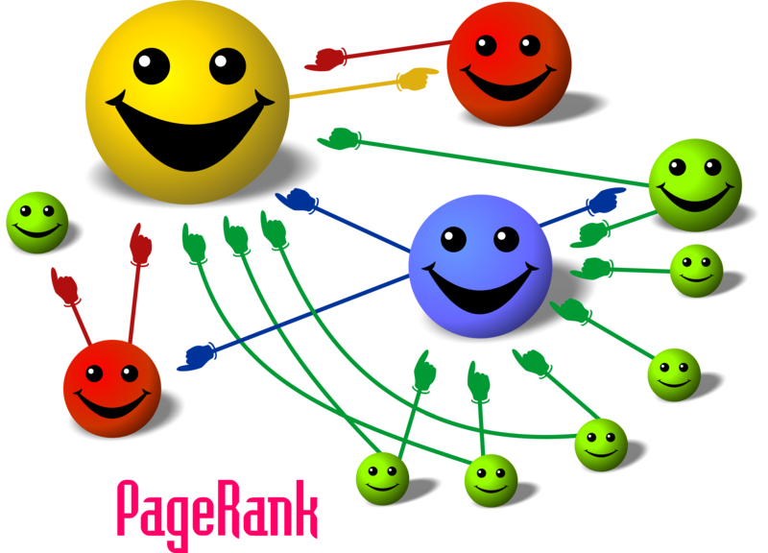
Img source: http://organicseoexpert.org/wp-content/uploads/2012/03/pagerank.png

Slide 8
Crowdsourcing
"the act of taking a job traditionally performed by a designated agent (usually an employee) and outsourcing it to an undefined, generally large group of people in the form of an open call." Jeff Howe, "The Rise of Crowdsourcing", Wired, Jun 2006

Slide 9
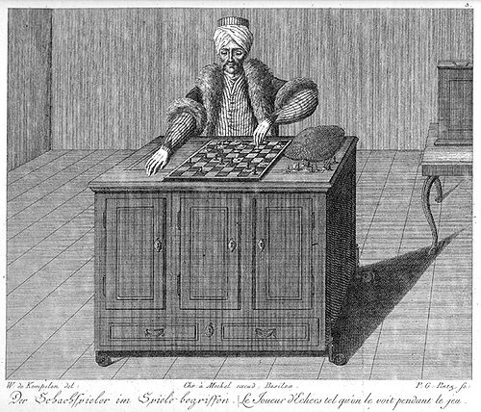
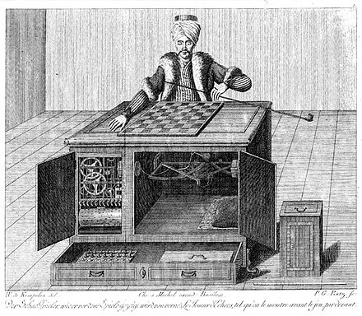
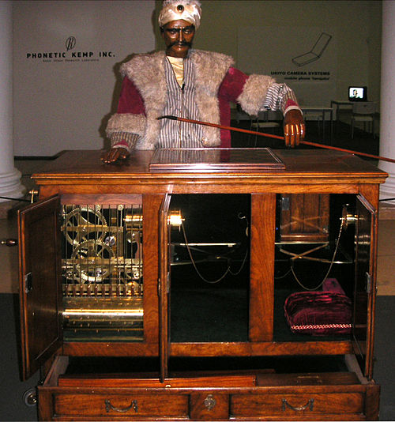
Mechanical Turk
The Turk (Wikipedia)

Slide 10
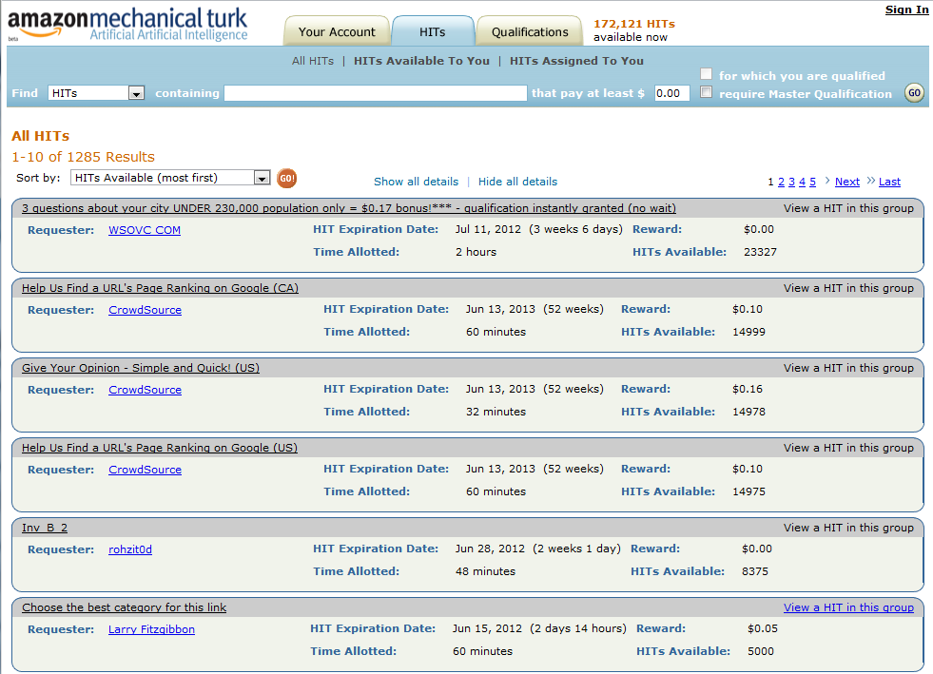
Amazon Mechanical Turk

Slide 11
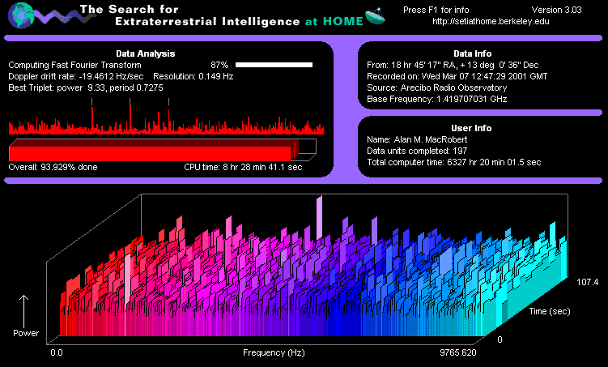
SETI@home Harvests Cycles From Idle Computers
SETI@home

Slide 12
Human Computation
"a paradigm for utilizing human processing power to solve problems that computers cannot yet solve." Luis van Ahn, Doctoral Dissertation at Carnegie Mellon, 2005
"Human computation:
The problems fit the general paradigm of computation, and as such might someday be solvable by computers.
The human participation is directed by the computational system or process." Quinn and Bedderson, CHI 2011

Slide 13
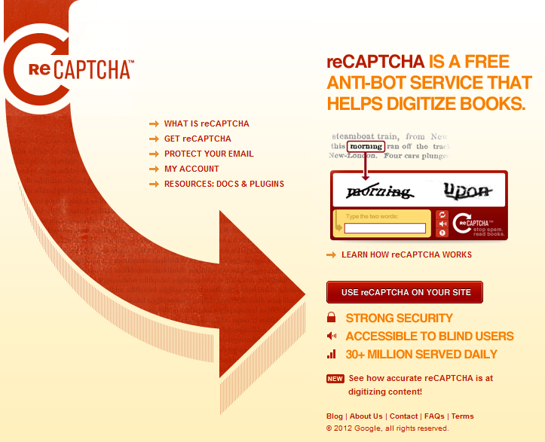
reCAPTCHA v3, Google's New Street View Image Recognition Algorithm Can Beat Most CAPTCHAs
Goodfellow et al., "Multi-digit Number Recognition from Street View Imagery using Deep Convolutional Neural Networks", 2014

Slide 14
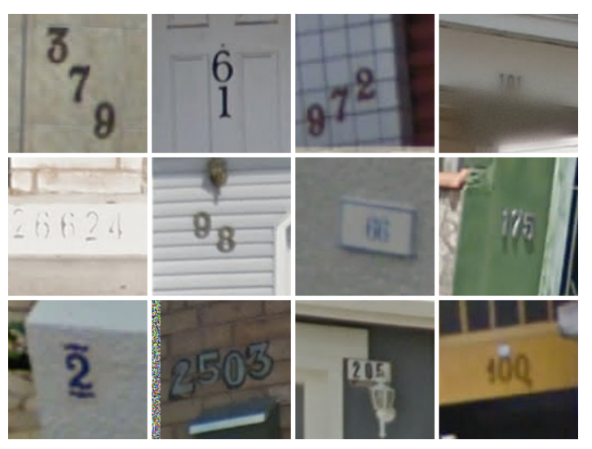
How Google Cracked House Number Identification in Street View

Slide 15
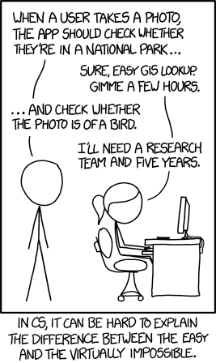
In the 60s, Marvin Minsky assigned a couple of undergrads to spend the summer programming a computer to use a camera to identify objects in a scene. He figured they'd have the problem solved by the end of the summer. Half a century later, we're still working on it.
Tasks (XKCD)

Slide 16
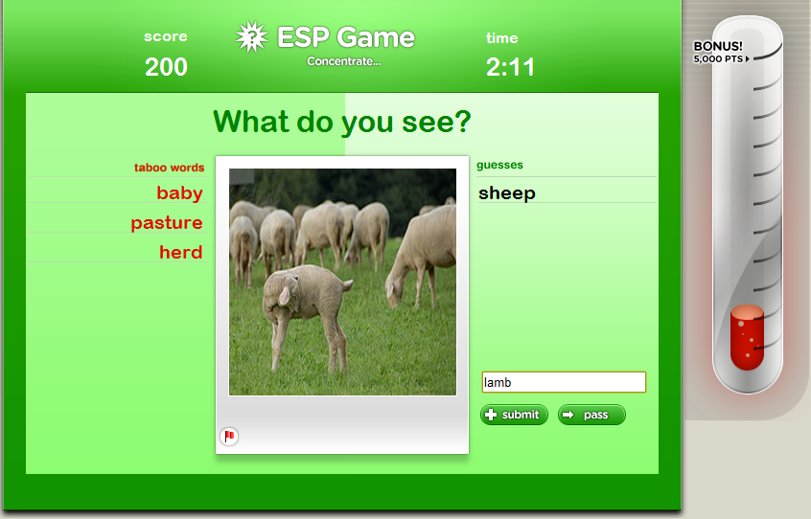
ESP game (Wikipedia)

Slide 17

Google licensed ESP for ImageLabeler
ImageLabeler (Google)

Slide 18
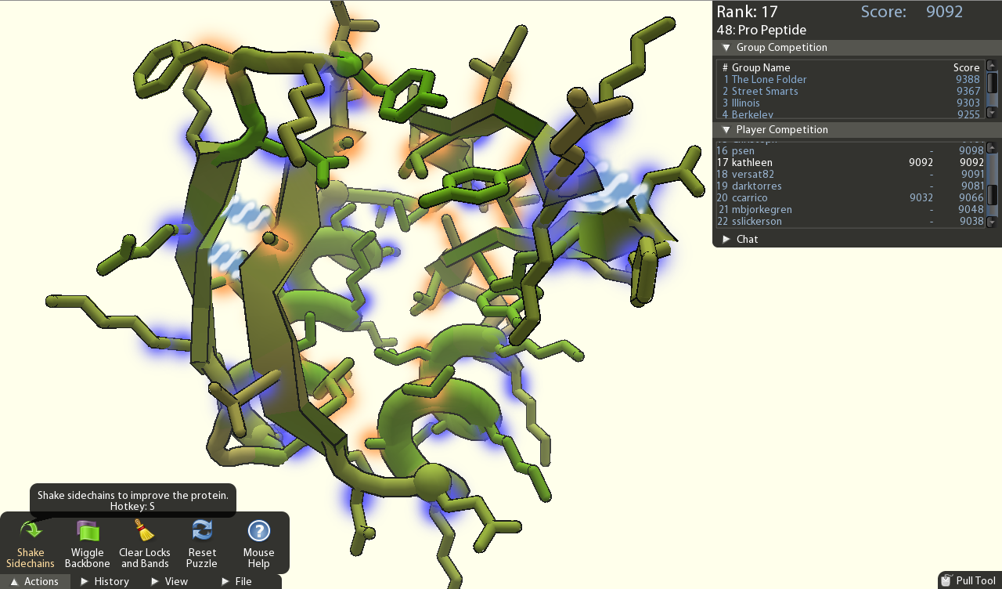
FoldIt
Foldit: Solve Puzzles for Science

Slide 19
CI not superset of HC
Human Computation
HC system could use single person working in isolation
Crowd- sourcing
Social Computing
Collective Intelligence
Data Mining

Slide 20
Crowdsourcing vs. Human Computation
Human Computation
"Whereas human computation replaces computers with humans, crowdsourcing replaces traditional human workers with members of the public." Quinn and Bedderson, CHI 2011
Crowd- sourcing
Social Computing
Collective Intelligence
Data Mining

Slide 21
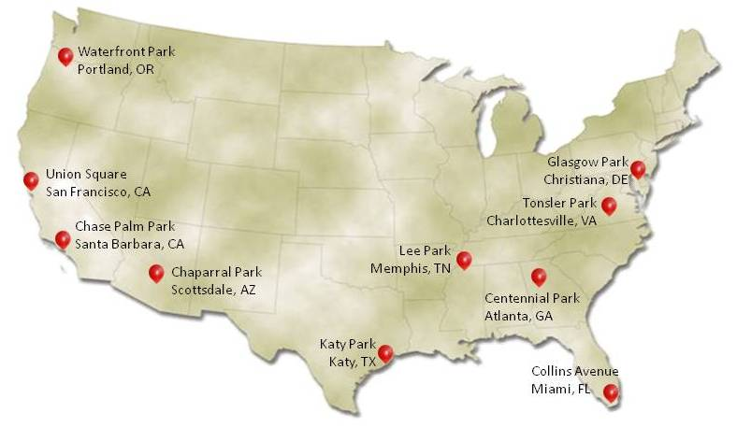
DARPA Network Challenge
Challenge: Find 10 red weather balloons set up by DARPA, from 10am - 5pm EST, Dec 5, 2009. They were prepared to run the challenge for 1 week.
MIT placed first (of 10 teams). They found all 10 in less 9 hours.
MIT’s Strategy: invitation-based network (with 4 initial members), finder gets $2000, with everyone in the invitation network getting 0.5 of the previous amount, with the remainder donated to charity.
DARPA Network Challenge (Wikipedia)
MIT site: MIT Red Balloon Challenge (archived)

Slide 22
Social Computing
"applications and services that facilitate collective action and social interaction online with rich exchange of multimedia information and evolution of aggregate
knowledge." Parameswaran and Whinston, Social Computing: An Overview, CAIS 19:37, 2007

Slide 23
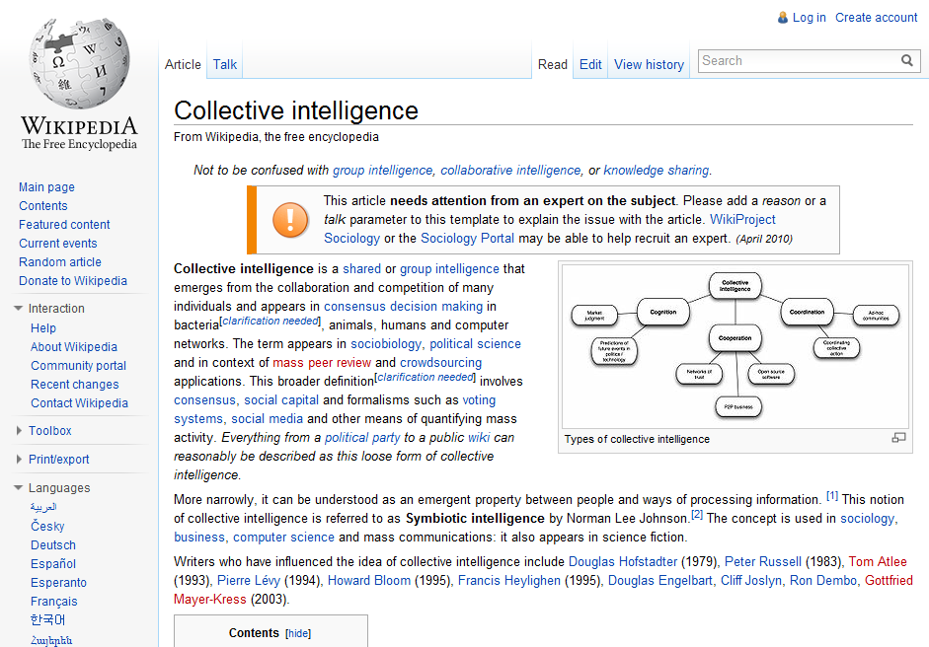
Collective intelligence (Wikipedia)

Slide 24
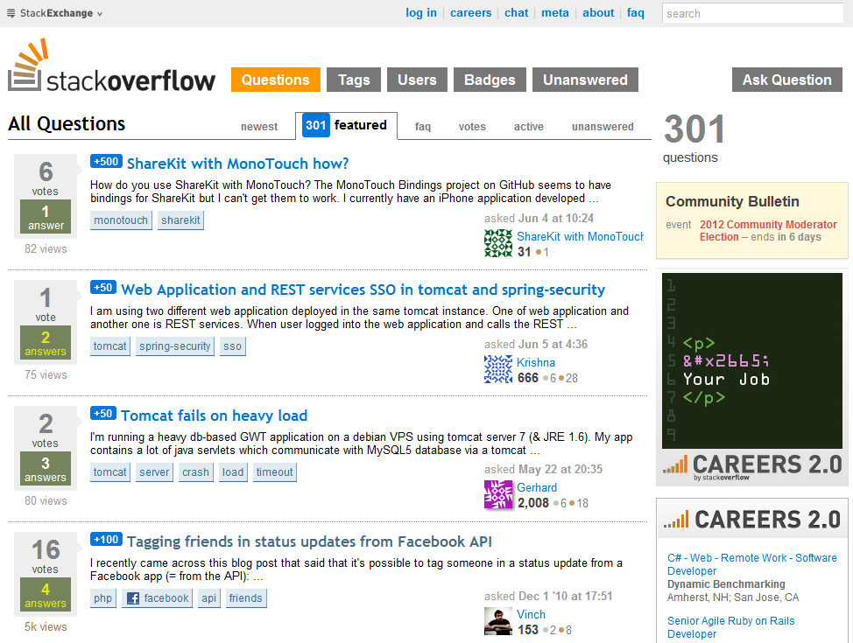

Slide 25
Data Mining
"the application of specific algorithms for extracting patterns from data." Fayyad, Piatetsky-Shapiro, and Smyth,
Knowledge Discovery and Data Mining: Towards a
Unifying Framework, Proc. KDD, 1996

Slide 26
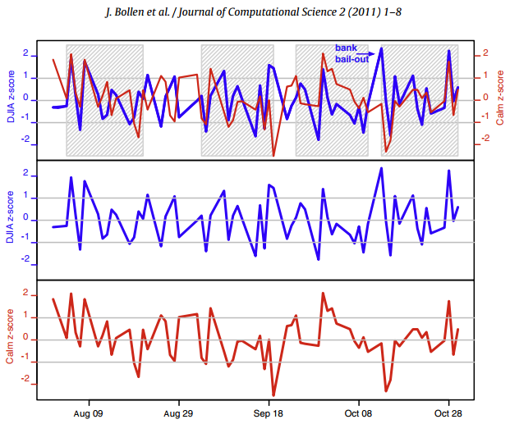
Bollen et al., Twitter mood predicts the stock market, 2011

Slide 27
Web Science:
Collective Intelligence & Recommender Systems
(Part 2 - Intro to Recommender Systems)
CS 432/532
Old Dominion University
Permission has been granted to use these slides from Frank McCown, Michael L. Nelson, Alexander Nwala, Michele C. Weigle
This work is licensed under a Creative Commons Attribution-NonCommercial-ShareAlike 3.0 Unported License

Slide 28
Main reference this week:
Ch 2 from Programming Collective Intelligence by Toby Segaran
(abbreviated as PCI)

Slide 29
Recommender Systems
Recommender (recommendation) systems recommend things to people based on their preferences or past behavior
Two general approaches:
Collaborative filtering
You'll like X because other people like you also liked X
Content-based (not covered in these slides)
You'll like X because it is very similar to other things you like

Slide 30
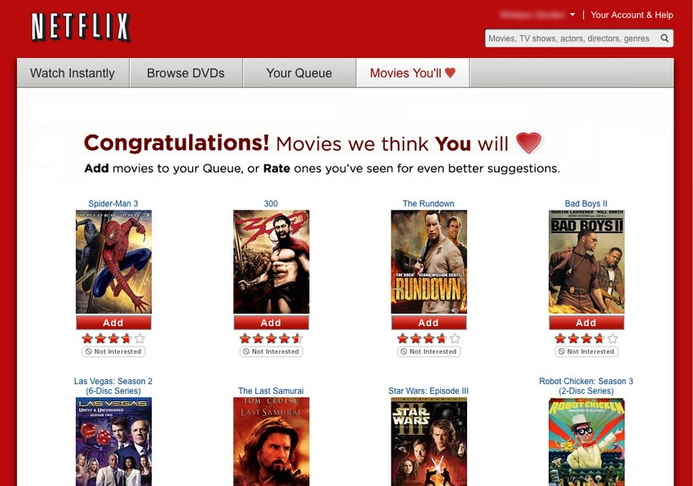
Image: http://lifehacker.com/5642050/five-best-movie-recommendation-services

Slide 31
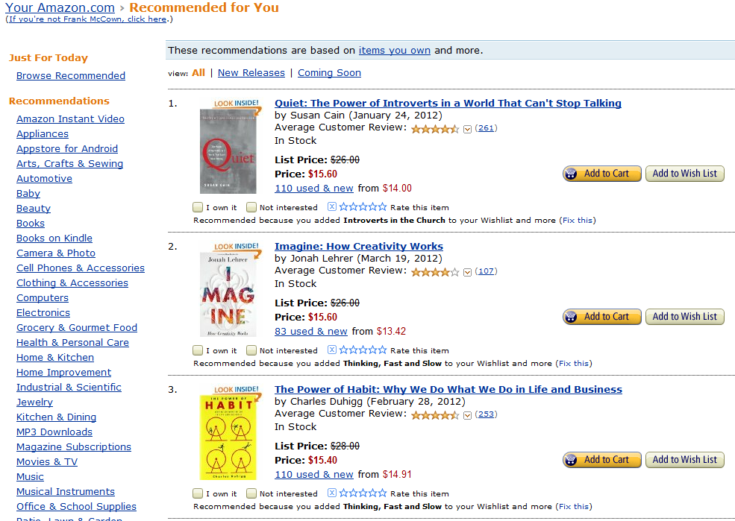

Slide 32
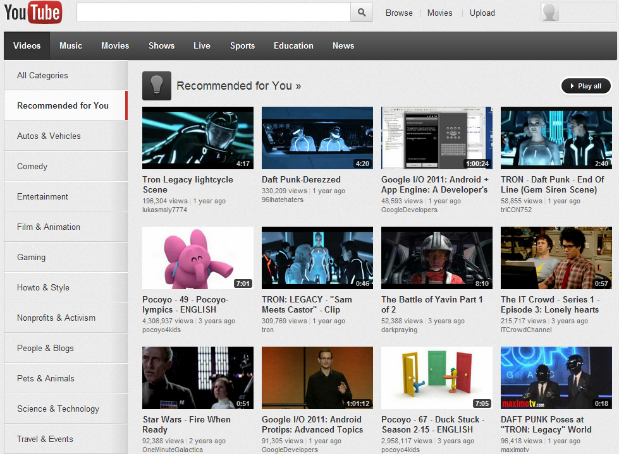

Slide 33
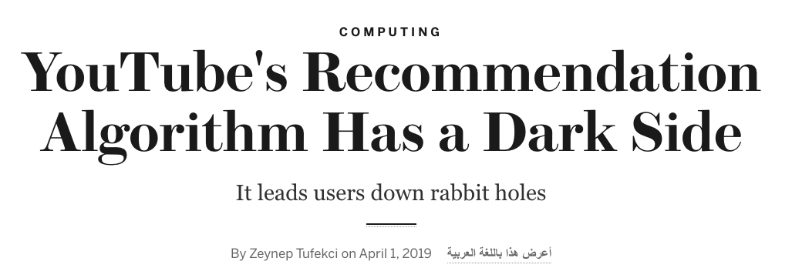
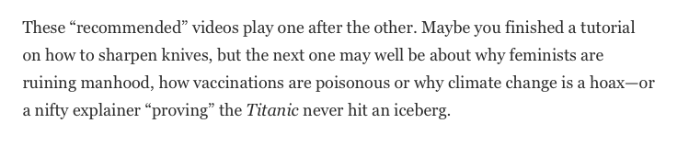
Zeynep Tufekci, YouTube's Recommendation Algorithm Has a Dark Side, Scientific American, 2019

Slide 34
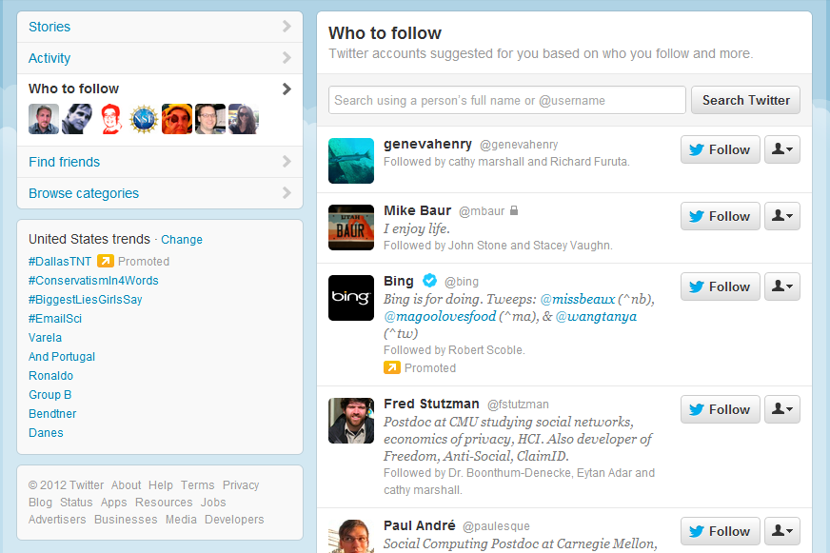

Slide 35


Slide 36
Collaborative Filtering
We often seek recommendations from people we trust (family, friends, colleagues, experts)
But who to ask for a recommendation is also based on similarity in taste
I trust my sister with my life, but she doesn't like the same movies I like
People with my tastes are likely to recommend things I will like
CF searches a large group of people for those that like the things you like, and it combines the things they like into a ranked list of suggestions

Slide 37
Web Science:
Collective Intelligence & Recommender Systems
(Part 3 - Recommending a Movie)
CS 432/532
Old Dominion University
Permission has been granted to use these slides from Frank McCown, Michael L. Nelson, Alexander Nwala, Michele C. Weigle
This work is licensed under a Creative Commons Attribution-NonCommercial-ShareAlike 3.0 Unported License

Slide 38
Main reference this week:
Ch 2 from Programming Collective Intelligence by Toby Segaran
(abbreviated as PCI)
GitHub repo

Slide 39
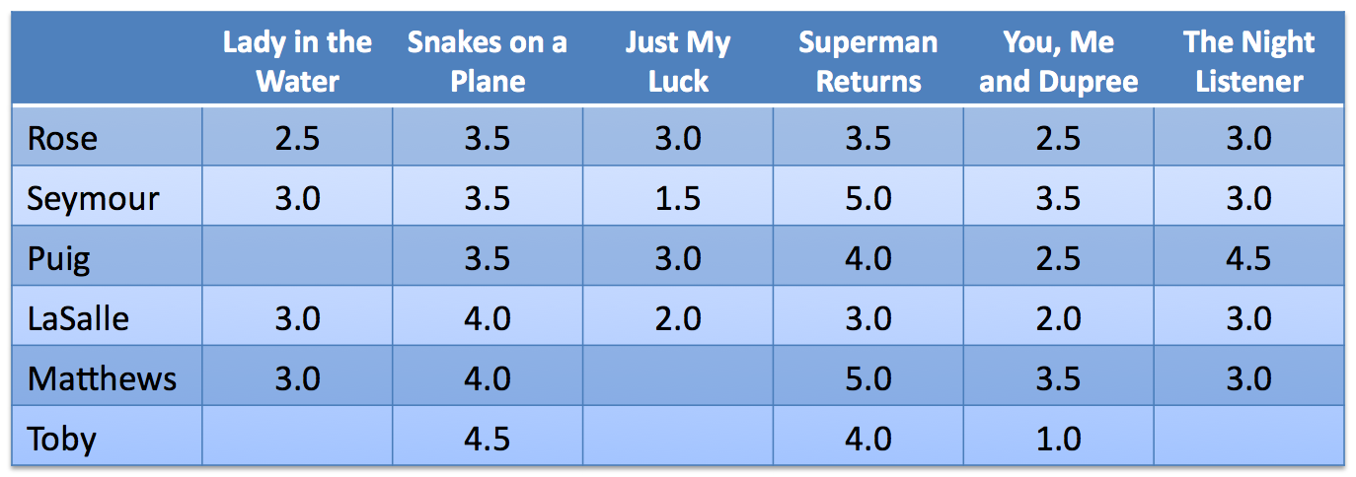
Example Data: Movie Ratings
Example from Ch 2 of PCI (data in code on pg. 8)
Let's visualize the data on a scatterplot…

Slide 40
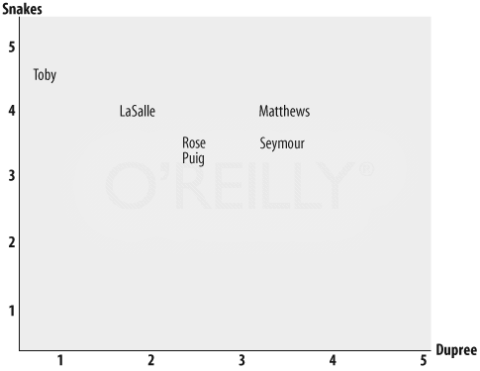
Ratings for Snakes… and ...Dupree
Fig 2-1, PCI, "How to Find Similar Users with Python", archived page

Slide 41
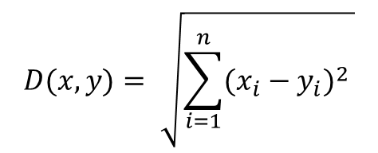
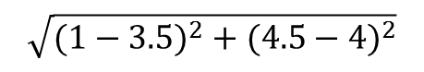
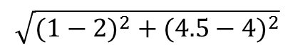
Euclidean Distance Score
2.5495
1.1180
D(Toby, Matthews) =
= 2.5495
D(Toby, LaSalle) =
= 1.1180
PCI, pgs. 8-15, "How to Find Similar Users with Python", archived page

Slide 42
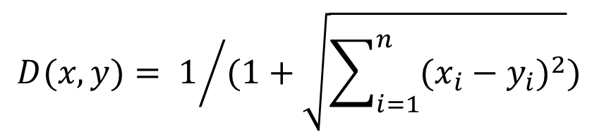
Modified Euclidean Distance Score
Most similarity metrics use range [0,1]
0 = no similarity
1 = exactly the same
Modify Euclidean Distance (to measure similarity)

Slide 43
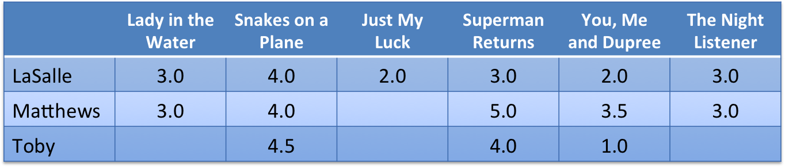
Modified Euclidean Distance Score
Distance(Toby, LaSalle) - original distance value was 1.1180
Distance(Toby, Matthews) - original distance value was 2.5495

Slide 44
Pearson Correlation Coefficient
Problem with Euclidean distance
Ratings for A: 5, 4, 3 Ratings for B: 3, 2, 1
although A and B seem to share roughly same opinions, distance between ratings are significant
Pearson's r corrects for "grade inflation"
Yields values between 1 and -1 1 = perfect correlation 0 = no correlation -1 = inverse correlation

Slide 45
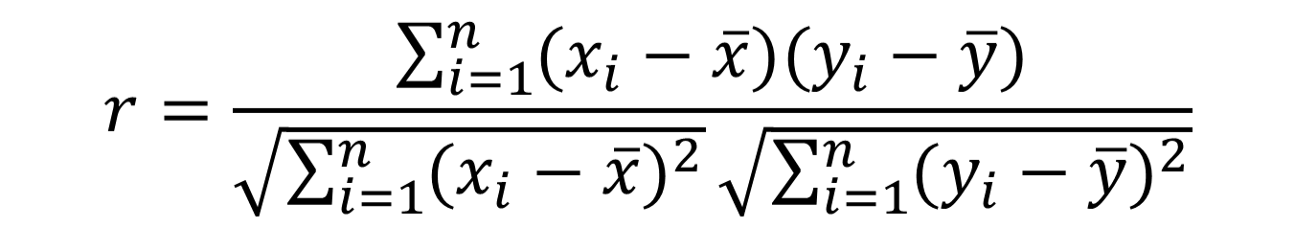
Calculating Pearson's r
x = User 1’s ratings of all items rated by both users
y = User 2’s ratings of all items rated by both users
x = mean of all User 1’s ratings
y = mean of all User 2’s ratings

Slide 46
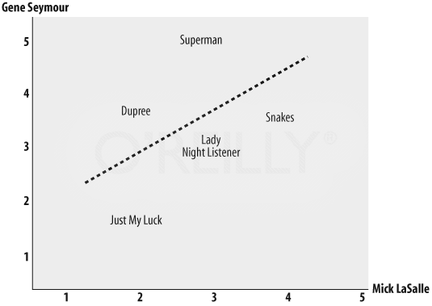
Comparing Two Critics' Ratings
Further distance means less correlation
Best-fit line
Pearson's r = 0.4
PCI, pgs. 8-15, "How to Find Similar Users with Python", archived page

Slide 47
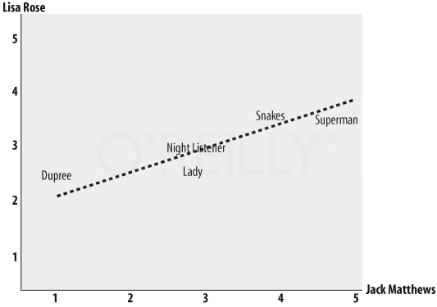
Comparing Two Critics' Ratings
Pearson's r = 0.75
Gives higher scores
PCI, pgs. 8-15, "How to Find Similar Users with Python", archived page

Slide 48
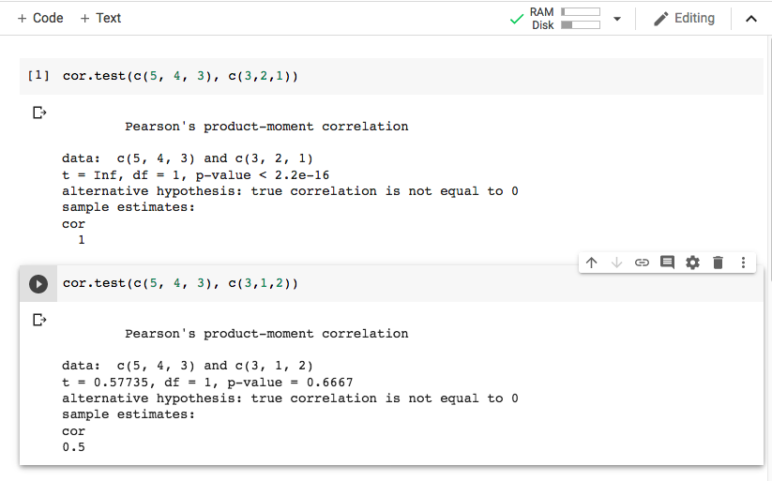
Pearson's r in R
Create new R Google Colab notebook
Python: scipy.stats.pearsonr — SciPy v1.5.3 Reference Guide, and pg. 13 in PCI

Slide 49
Other Similarity Measures
Cosine similarity (Wikipedia)
Jaccard coefficient (Wikipedia)
Manhattan (taxicab) distance (Wikipedia)
Others…

Slide 50
Moving On…
Should Toby see these movies?
PCI, pgs. 15-19

Slide 51
Who Should We Ask?
To find recommendations for movies we have not seen, we could…
Find a single critic whose taste best matches ours
What if they haven't rated a movie we are interested in?
Get all critics' input but give critics with similar tastes more impact on decision
For option 2, use similarity metric to compare all ratings with ours, and compute average rating based on weighted similarity

Slide 52
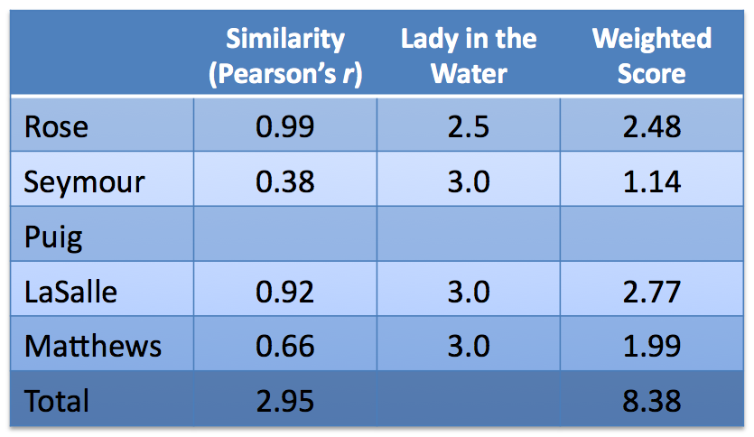
Should Toby See "Lady in the Water"?
Higher values influence Weighted Avg more
All Toby's ratings compared to other critics'
0.99 × 2.5
Not included in Total since no rating for Lady in the Water
Weighted Avg = Weighted Total / Similarity Total = 8.38/2.95 = 2.83
Toby is likely to rate this movie 2.83

Slide 53
Product Recommendations
Previous example used distance metric to find critics with similar taste
What if we want to find movies that are similar to some given movie?
Solution: Use same method but swap rows and columns

Slide 54
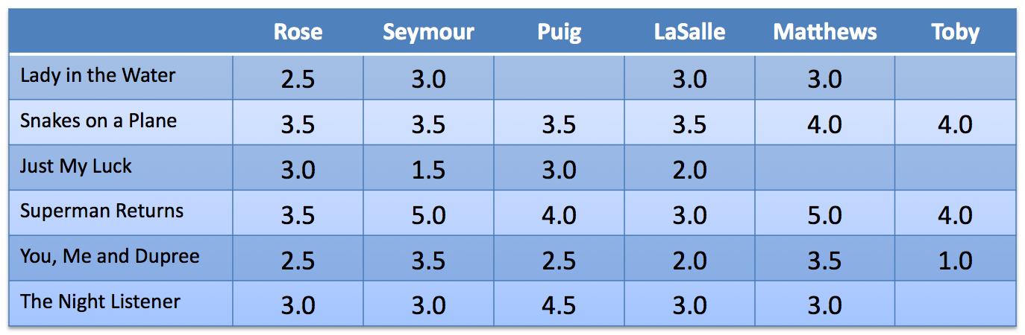
Rows and Columns Swapped
Find movies like Superman Returns by comparing its row with all other rows…

Slide 55
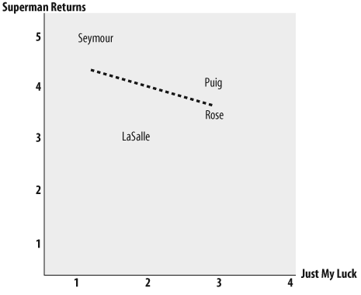
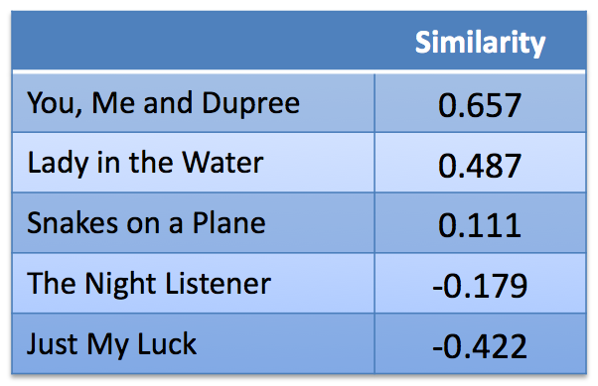
Movies Similar to Superman Returns
Negative correlation!
Fig 2-5 from PCI
If you like Superman Returns, you probably won't like Just My Luck (and vice versa)!

Slide 56
Web Science:
Collective Intelligence & Recommender Systems
(Part 4 - Challenges for Collaborative Filtering)
CS 432/532
Old Dominion University
Permission has been granted to use these slides from Frank McCown, Michael L. Nelson, Alexander Nwala, Michele C. Weigle
This work is licensed under a Creative Commons Attribution-NonCommercial-ShareAlike 3.0 Unported License

Slide 57
Challenges for Collaborative Filtering
Ratings data is often sparse
Large data sets required
Cold start problem: new users must first rate a number of items before CF can work
Comparing all items against all users is not efficient/scalable
Compare against a sample
Use clustering algorithm to locate best neighbors
Clustering algorithms are covered in Ch 3 of Programming Collective Intelligence

Slide 58
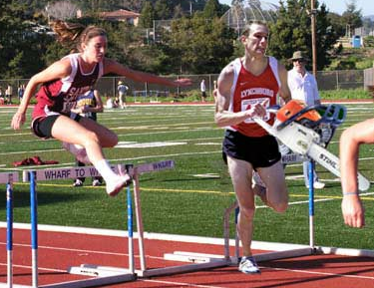
Challenges for Collaborative Filtering
Susceptible to cheating (Shilling attacks)
Rate your own products higher and your competitors lower
Rate like everyone else except a select few items you want recommended to others
Lam and Riedl, "Shilling Recommender Systems for Fun and Profit", WWW 2004
Img source: http://www.somethingawful.com/d/photoshop-phriday/cheating-in-sports.php

Slide 59
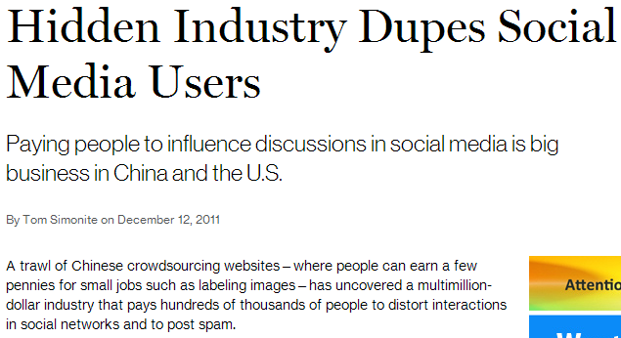
Say it isn't true!
Hidden Industry Dupes Social Media Users
Astroturfing (Wikipedia)
OSoMe (Observatory on Social Media), Indiana University

Slide 60
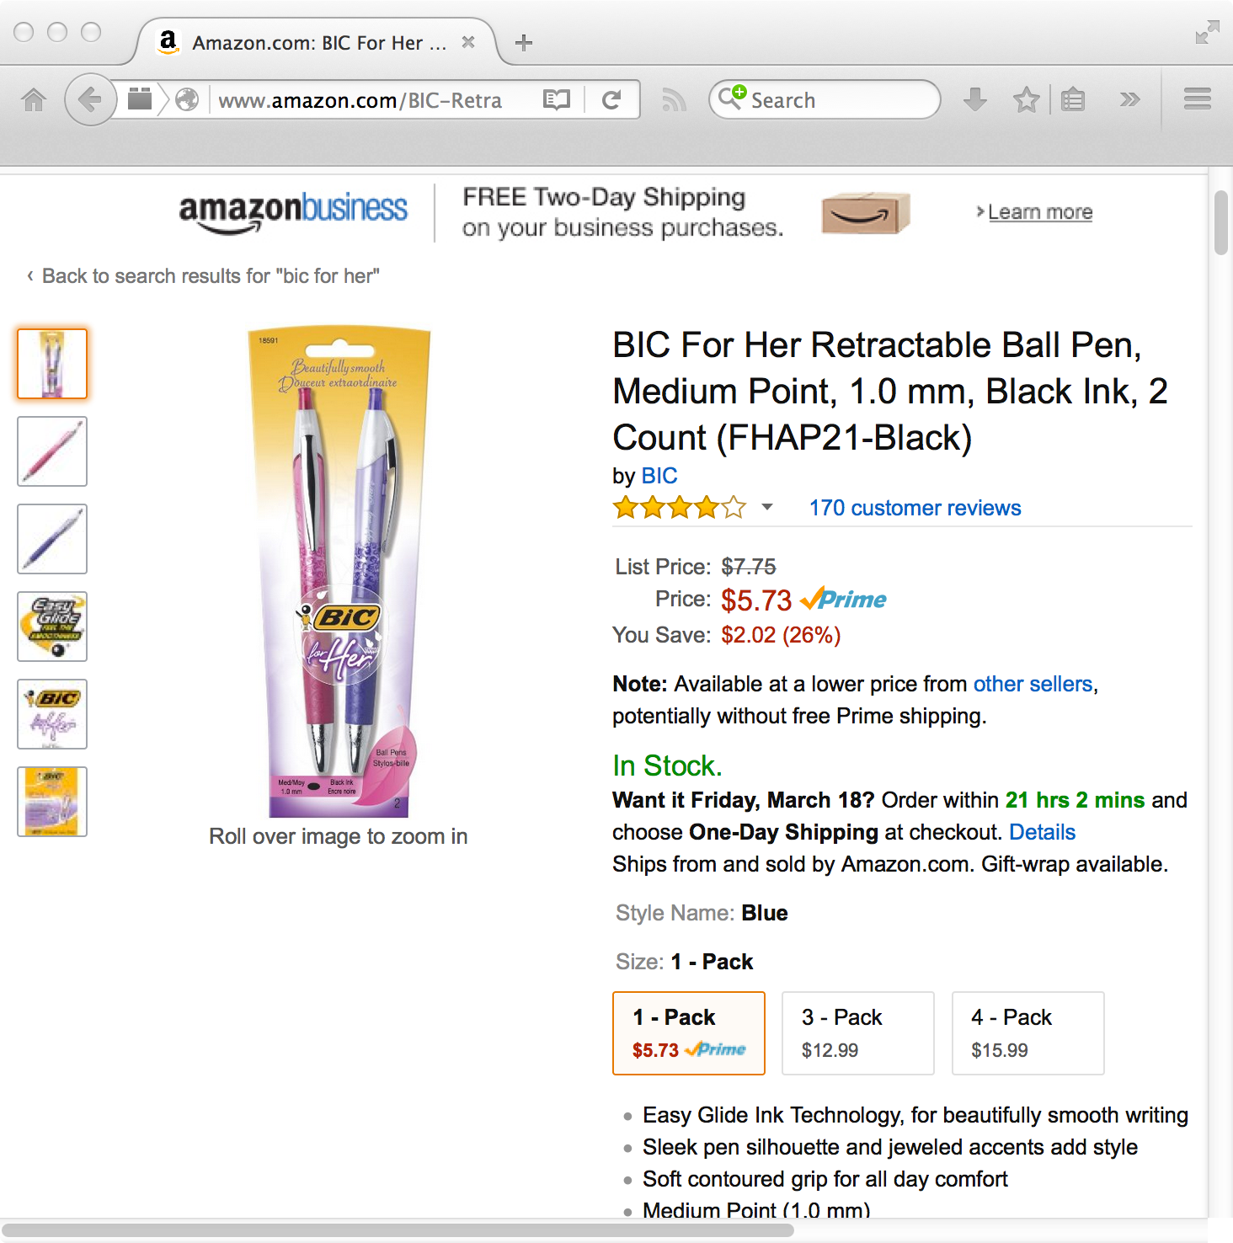
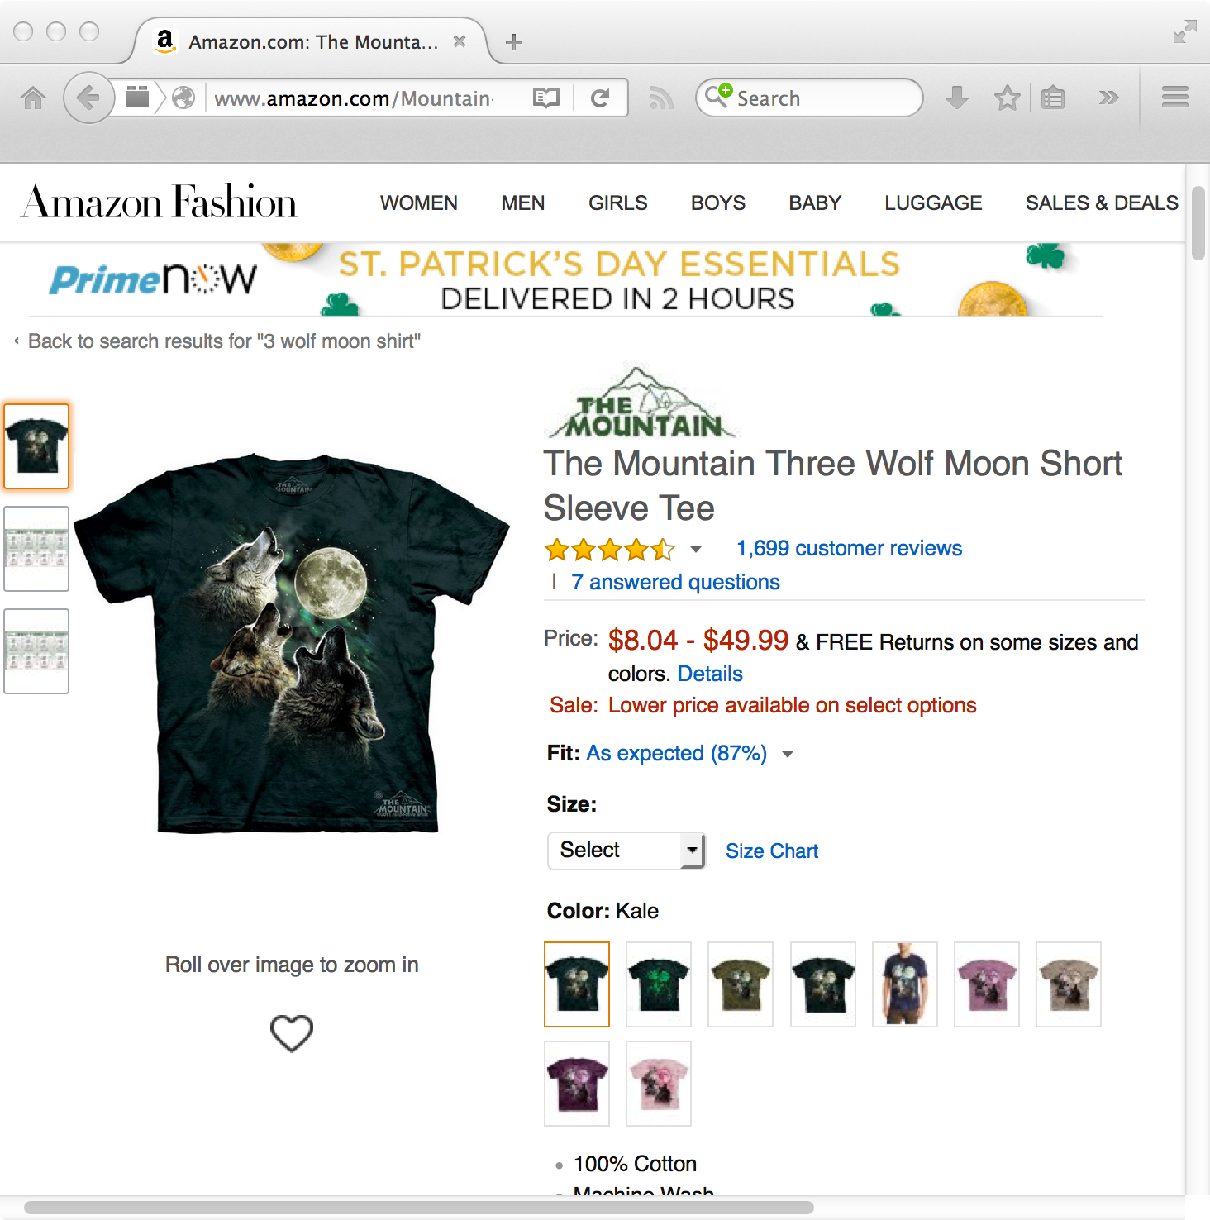
Some reviews are sarcastic…
5.0 out of 5 stars Received As Wedding Gift- LOVE THEM!
By agilerton on August 28, 2012
Style Name: BlueSize: 1 - Pack
I received a set of these pens for my wedding. Unfortunately I can't write or type (my husband is actually typing for me.) However, I do so love the pretty colors. I've been learning how to write with them. …
5.0 out of 5 starsGreat compliment for my skin art
By overlook1977 on May 19, 2009
Size: MediumColor: Dark Green
Unfortunately I already had this exact picture tattooed on my chest, but this shirt is very useful in colder weather.
The Mountain Men's Three Wolf Moon Short Sleeve Tee at Amazon.com
BIC For Her Retractable Ball Pen at Amazon.com

Slide 61
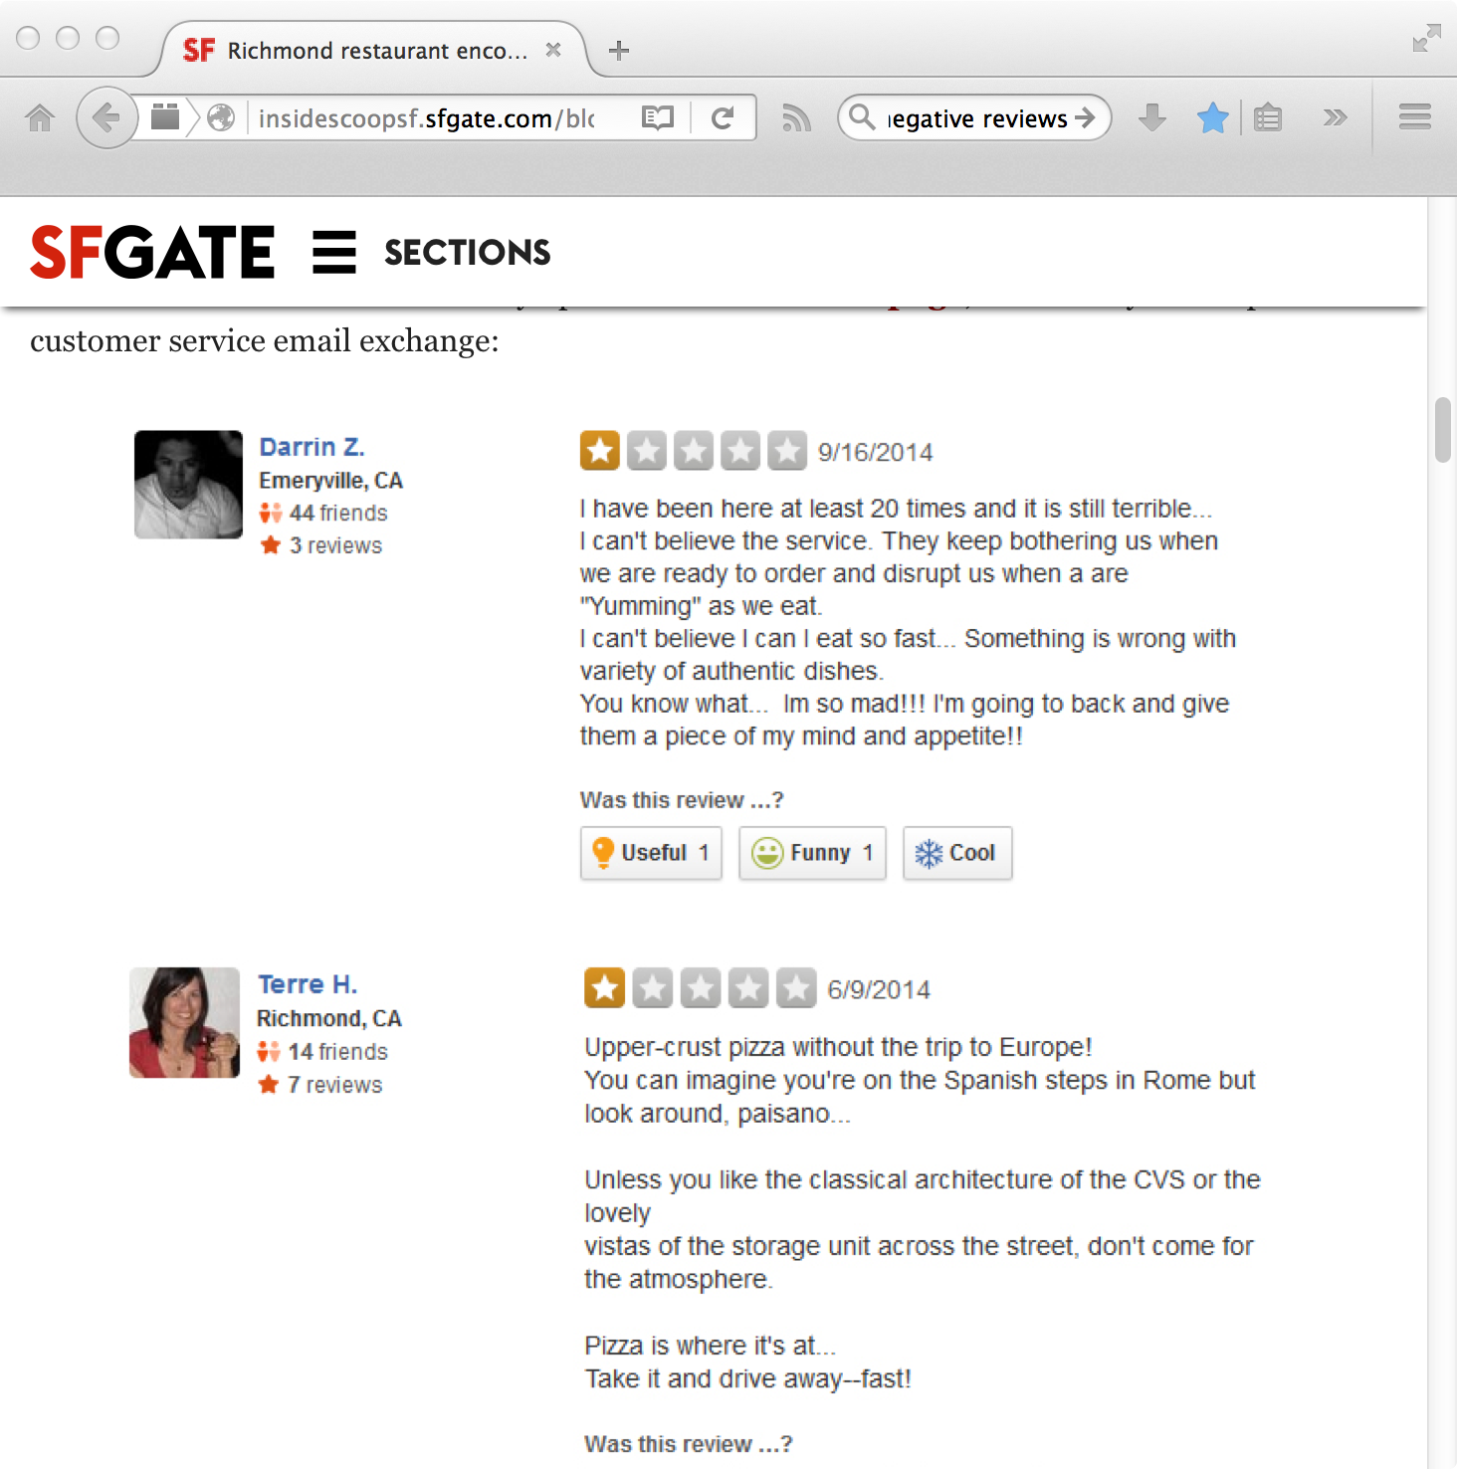
Some are protests.
Richmond restaurant encourages bad Yelp reviews
Botto Italian Bistro (yelp)

Slide 62
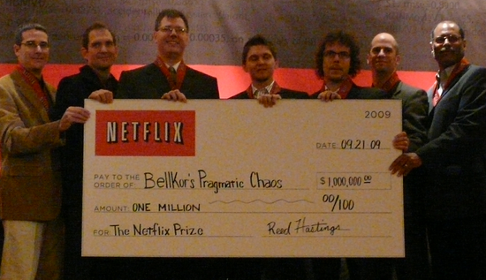
Netflix Prize
Netflix Prize (Oct 2006): $1M for beating Netflix's collaborative filtering algorithm by 10%
Dataset: 100,480,507 ratings that 480,189 anonymized users gave to 17,770 movies
Started with 50,051 contestants
Only two teams had winning
solutions by contest closing (July 2009)
Img source: http://www.wired.com/images_blogs/business/2009/09/p1010915.jpg

Slide 63
How Did They Do It?
Insights that gave winning algorithms an edge:
People who rate a large number of movies at once are usually rating movies they saw a long time ago
People use different criteria when rating movies they saw a long time ago vs. recently seen
Some movies get better over time, others get worse
People rate movies differently depending on which day of the week it is
Combined hundreds of other algorithms which were precisely weighed and tuned
How the Netflix Prize Was Won by Buskirk, Wired 2009

Slide 64
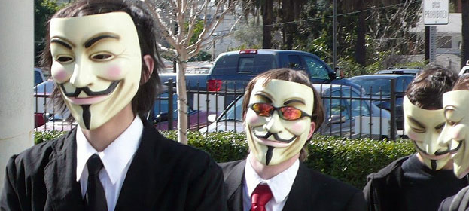
Netflix Prize 2
Second prize announced in 2009
FTC and lawsuits against Netflix about privacy
I thought the data was anonymized?
Img source: http://laist.com/2008/02/10/photo_essay_ano.php

Slide 65
Anonymizing Data Is Hard To Do…
In 2007 Narayanan and Shmatikov (Univ of Texas) were able to re-identify a number of the anonymous users in Netflix dataset by correlating movie ratings with IMDb ratings (full paper)
This has happened before…
In 2006 users in anonymized AOL search data were re-identified
In 2000 Latanya Sweeney showed 87% of all Americans could be uniquely identified with only zip code, birthdate, and gender
See Why Anonymous Data Sometimes Isn't by Bruce Schneier (2007)

Slide 66

Netflix gave up… no more prizes!

Slide 67
Objectives
Describe and define the four components of collective intelligence.
Explain how collaborative filtering is related to recommender systems.
Differentiate between Euclidean distance and the Pearson correlation coefficient.
List three challenges for collaborative filtering.

